Slide 1
Energy Leadership™ Index Debrief
Company/Team

Slide 2
Objectives

Slide 3
Pre-Meeting Questions
What is currently holding your team back from performing its best?
What are the biggest challenges your team is facing?
What does your team do really well?
Notes:
Collect anonymously ahead of time if possible, to personalize the Level descriptions for the group.

Slide 4
Catabolic
Anabolic
Energy
Draining, resisting, destructive
Releases cortisol and adrenaline
Short-term energy
Constructive, building, healing
Releases testosterone, endorphins, and dopamine

Slide 5
Energetic Self-Perception Chart

Slide 6
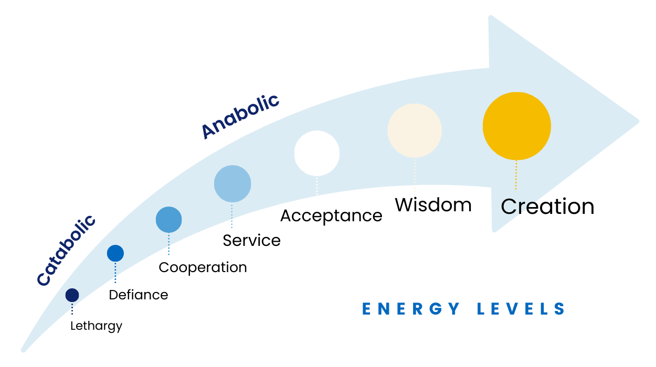
The 7 Levels of Energy
Notes:
Short version - refresh memories of participants with quick overview of the 7 Levels

Slide 7
Group ELI Results
Notes:
Add a snapshot of your group results here.

Slide 8
Level 1
CORE
THOUGHT:
Victim
CORE FEELING/
EMOTION:
Apathy
CORE ACTION/
RESULT:
Lethargy
Notes:
Long version- go through each Level, especially group descriptors, matching language from pre-questions

Slide 9
How does Level 1 Energy show up for your team?
Notes:
Small groups - share aloud
Big groups - can jot down notes or do breakouts as time permits

Slide 10
Level 2
CORE
THOUGHT:
Conflict
CORE FEELING/
EMOTION:
Anger
CORE ACTION/
RESULT:
Defiance
Notes:
Can include group EP/ESR % of Level 1 here

Slide 11
How does Level 2 Energy show up for your team?
Notes:
Small groups - share aloud
Big groups - can jot down notes or do breakouts as time permits

Slide 12
Level 3
CORE
THOUGHT:
Responsibility
CORE FEELING/
EMOTION:
Forgiveness
CORE ACTION/
RESULT:
Cooperation

Slide 13
How does Level 3 Energy show up for your team?
Notes:
Small groups - share aloud
Big groups - can jot down notes or do breakouts as time permits

Slide 14
Level 4
CORE
THOUGHT:
Concern
CORE FEELING/
EMOTION:
Compassion
CORE ACTION/
RESULT:
Service

Slide 15
How does Level 4 Energy show up for your team?
Notes:
Small groups - share aloud
Big groups - can jot down notes or do breakouts as time permits

Slide 16
Level 5
CORE
THOUGHT:
Reconciliation
CORE FEELING/
EMOTION:
Peace
CORE ACTION/
RESULT:
Acceptance

Slide 17
When does your team display Level 5 Energy?
What would it look like to have more Level 5?
Notes:
Small groups - share aloud
Big groups - can jot down notes or do breakouts as time permits

Slide 18
Level 6
CORE
THOUGHT:
Synthesis
CORE FEELING/
EMOTION:
Joy
CORE ACTION/
RESULT:
Wisdom

Slide 19
When does your team display Level 6 Energy?
What would it look like to have more Level 6?
Notes:
Small groups - share aloud
Big groups - can jot down notes or do breakouts as time permits

Slide 20
Level 7
CORE
THOUGHT:
Non-Judgment
CORE FEELING/
EMOTION:
Absolute Passion
CORE ACTION/
RESULT:
Creation

Slide 21
How might Level 7 Energy serve your team?
Notes:
Small groups - share aloud
Big groups - can jot down notes or do breakouts as time permits

Slide 22
Group Results

Slide 23
Reflection
What patterns do you notice in the group results?
What surprised you about the results?
Looking back at your pre-meeting questions, how do you think your group’s energy plays a role in both the challenges and strengths of your team?
What’s one thing you can do this week to become more aware of your own Energy Level? Your team’s Energy Level?
What ideas do you have about how to increase Anabolic Energy on your team?

Slide 24
Next Steps
(optional: add your CTA here, package options, etc.)

